Slide 1
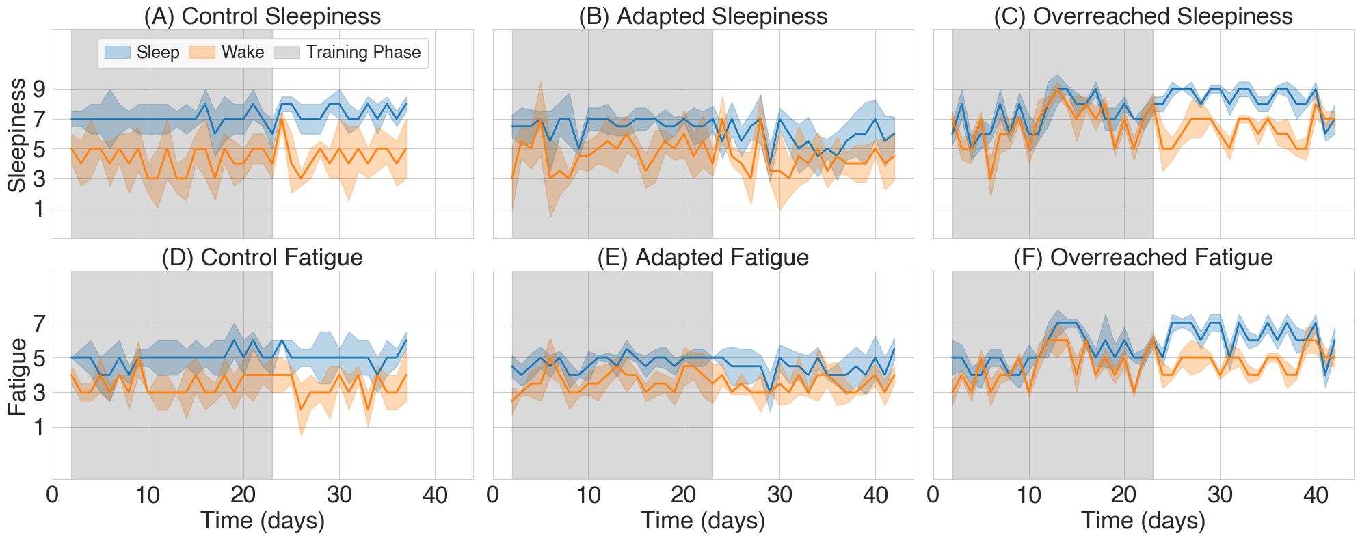
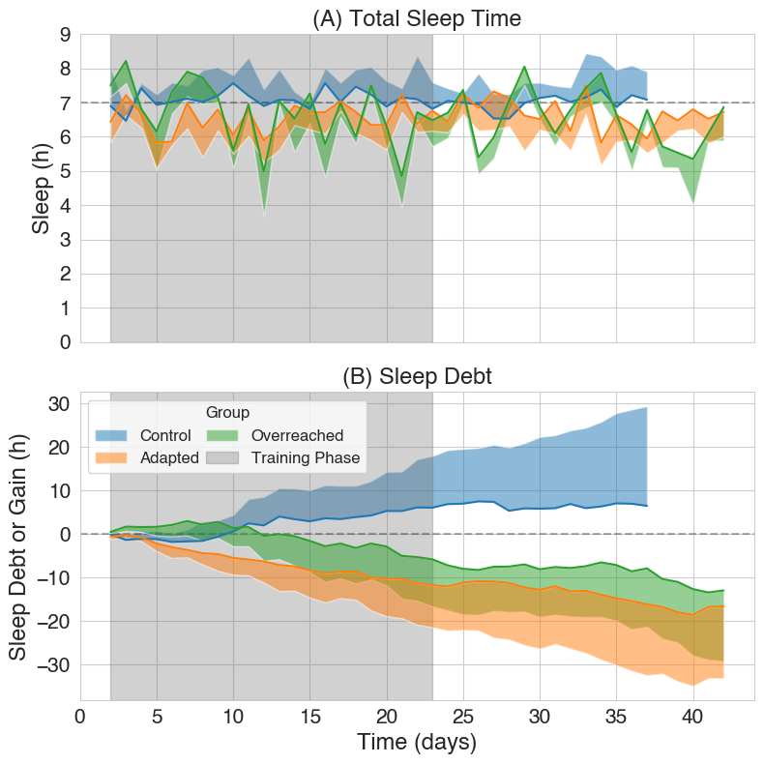
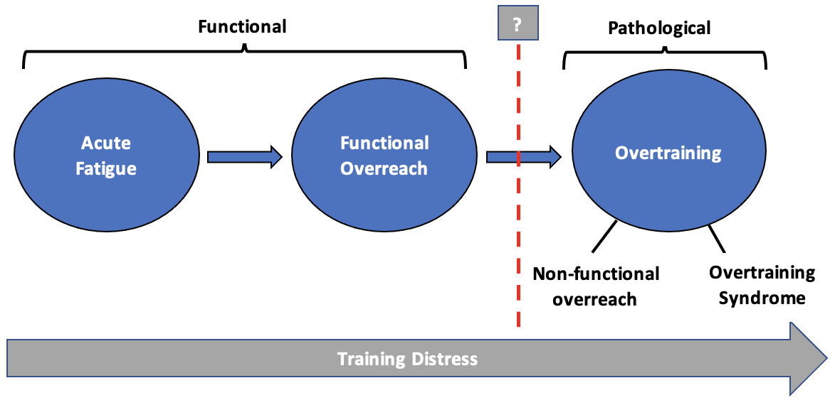
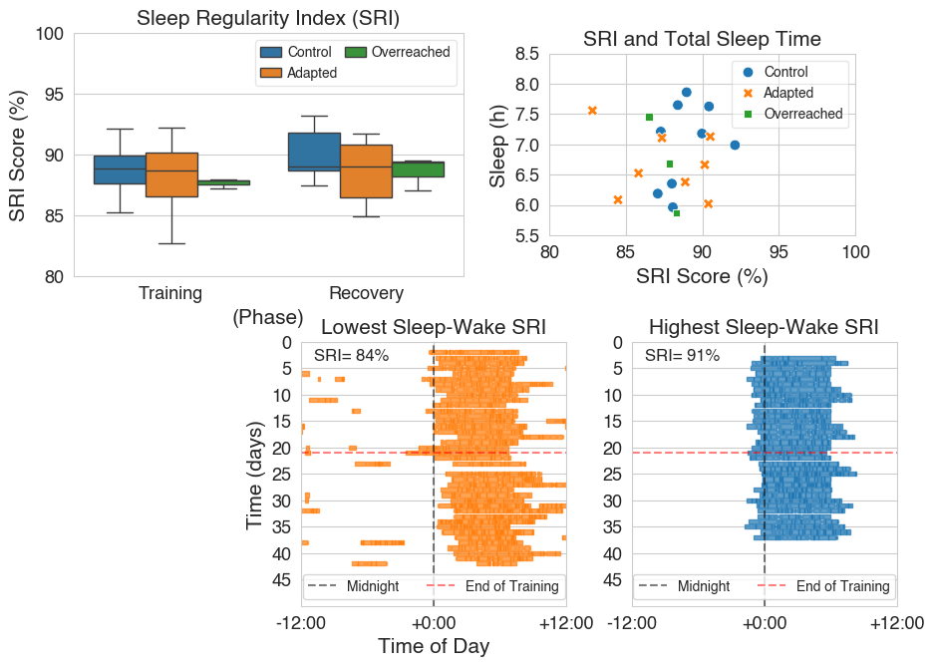
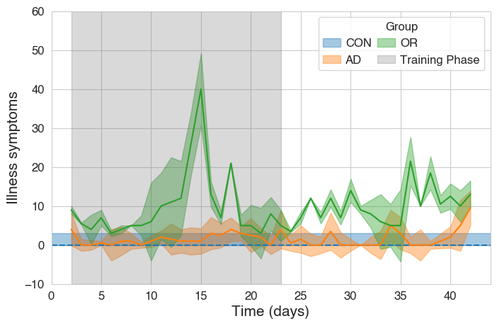
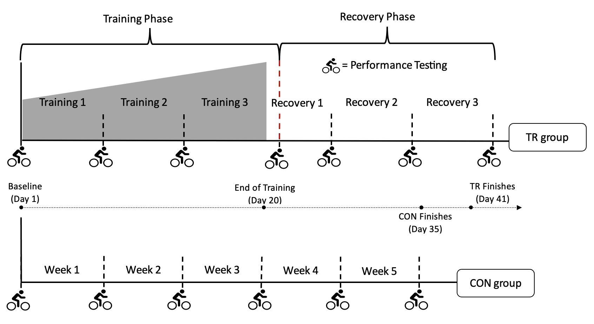
SLEEP PATTERNS OF RECREATIONALLY ACTIVE ADULTS THROUGHOUT A THREE-WEEK HIGH-INTENSITY OVERREACHING TRAINING PROTOCOL.
After intensified training, overtrained individuals experience:
Excessive fatigue and sleepiness—both at bedtime and upon waking.
increased illness symptoms.
Intensified training does not appear to affect sleep regularity.
Thomas Gooding, Ian Rasmussen, Amanda Lamp, Hans Haverkamp
Occupational Sleep Medicine Group, Sleep and Performance Research Center, Department of Translational Medicine and Physiology, Elson S. Floyd College of Medicine, Washington State University
Background:
Overtraining is a maladaptive training response caused by excessive training stress and/or inadequate recovery.
The hallmark symptom of overtraining is an unexplained reduction in performance. Secondary symptoms can include worsened mood states, higher incidence of illness, and neuroendocrine dysfunction.
Sleep, athletic performance, and immune system function share bi-directional relationships with one another.
Overtrained individuals often report sleep disturbances; however, it is unclear whether poor sleep contributes to overtraining progression or are merely a symptom.
Methods:
Study participants were randomized into a training group (TR, n=11) or control group (CON, n=9). TR group underwent a three-week high-intensity training protocol, followed by three weeks of recovery.
Sleep was measured using actigraphy and paired sleep surveys.
Illness symptoms were assessed using the Wisconsin Upper Respiratory Illness Symptoms Score (WURSS-11).
After training, three TR participants were considered overreached (OR), evidenced by a decrease in performance (-10.38 ± 5.55% from baseline); other TR participants (n=8) were considered adapted (AD).
Contact: Thomas.Gooding@wsu.edu

Slide 2
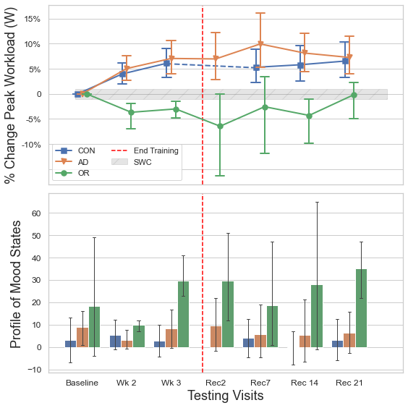

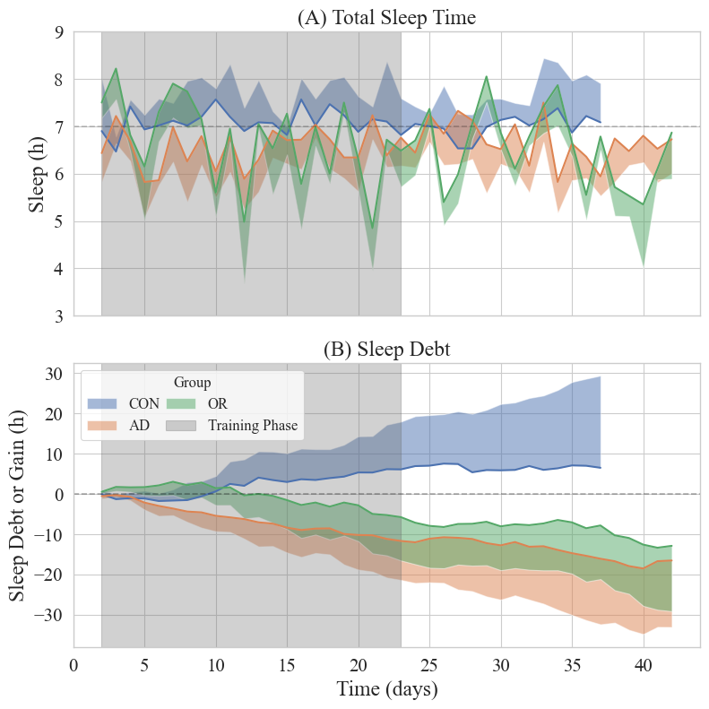
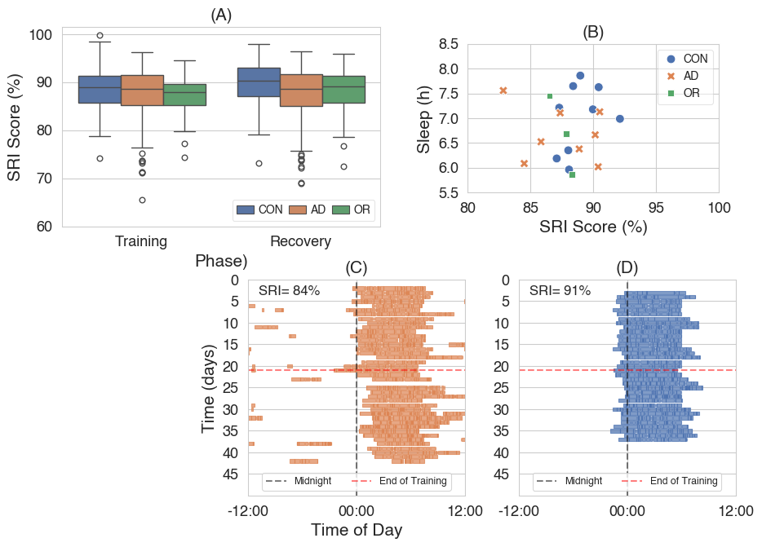
SLEEP PATTERNS OF RECREATIONALLY ACTIVE ADULTS THROUGHOUT A THREE-WEEK HIGH-INTENSITY OVERREACHING TRAINING PROTOCOL.
After intensified training, overtrained individuals experience:
Excessive fatigue and sleepiness—both at bedtime and upon waking.
increased illness symptoms.
Intensified training does not appear to affect sleep regularity.
Thomas Gooding, Ian Rasmussen, Amanda Lamp, Hans Haverkamp
Occupational Sleep Medicine Group, Sleep and Performance Research Center, Department of Translational Medicine and Physiology, Elson S. Floyd College of Medicine, Washington State University
Background:
Overtraining is a maladaptive training response caused by excessive training stress and/or inadequate recovery.
The hallmark symptom of overtraining is an unexplained reduction in performance. Secondary symptoms can include worsened mood states, higher incidence of illness, and neuroendocrine dysfunction.
Sleep, athletic performance, and immune system function share bi-directional relationships with one another.
Overtrained individuals often report sleep disturbances; however, it is unclear whether poor sleep contributes to overtraining progression or are merely a symptom.
Methods:
Study participants were randomized into a training group (TR, n=11) or control group (CON, n=9). TR group underwent a three-week high-intensity training protocol, followed by three weeks of recovery.
Sleep was measured using actigraphy and paired sleep surveys.
Illness symptoms were assessed using the Wisconsin Upper Respiratory Illness Symptoms Score (WURSS-11).
After training, three TR participants were considered overreached (OR), evidenced by a decrease in performance (-10.38 ± 5.55% from baseline); other TR participants (n=8) were considered adapted (AD).
Contact: Thomas.Gooding@wsu.edu

Slide 3






Title
Authors
Intro
–––––––––––––––––––
––––––––––––––––
––––––––––––––
––––––––––––––––––
Methods
–––––––––––––––––––
–––––––––––––––––––
–––––––––––––––––––
–––––––––––––––––––
Results
–––––––––––––––––––
––––––––––––––––
––––––––––––––––––
Discussion
–––––––––––––––
–––––––––––––––––––
–––––––––––––––––––
Extra Figures
& Tables
Main finding goes here,
translated into plain English.
Emphasize the important words.
Scan to
download the full poster

